Slide 1
CS 355/555
Probability and Statistics for CS
Baocheng Geng
Lecture 11, 02/010/2025
CS 355/555 Probability and Statistics for CS

Slide 2







Introduction
Discrete Random Variables
Introduction Random Variables
Examples: Random Variables
3 Probability Mass Function
Examples: Probability Mass Function
1
2
4 Functions of a Random Variable
5
Different types of Random Variables Uniform Random Variables Bernoulli Random Variable Binomial Random Variable Geometric Random Variable Poisson Random Variable
Functions of a Random Variable Section 2.3, pg 80
6
7 Next Time
CS 355/555 Probability and Statistics for CS

Slide 3
Copyright Statement
Copyright Statement
Materials prepared for and/or included in this course are protected by copyright law. They are intended to be used only by students enrolled in this course during the current term and should not be further disseminated without prior permission from the course instructor.
CS 355/555 Probability and Statistics for CS

Slide 4
Variable
Variable
x² − x − 6 = 0
5x² + 30x − 32 = 0
CS 355/555 Probability and Statistics for CS
4/36 10:18

Slide 5
Variable
Variable
x² − x − 6 = 0
5x² + 30x − 32 = 0
x has a value (or more than one).
CS 355/555 Probability and Statistics for CS
4/36 10:18

Slide 6
Random Variable
Random Variable
A real valued function of an outcome of an experiment.
X = the number of heads when I toss 4 coins.
The range of X is {0, 1, 2, 3, 4}
CS 355/555 Probability and Statistics for CS
5/36 10:18

Slide 7
Random Variable
Random Variable
A real valued function of an outcome of an experiment.
If the range is finite or countable, the Random Variable is discrete.
CS 355/555 Probability and Statistics for CS
5/36 10:18

Slide 8
Random Variable
Random Variable
A real valued function of an outcome of an experiment.
If the range is finite or countable, the Random Variable is discrete. Usually X, Y , and other capital letters are random variables.
x,y, and other lower case letters are values a random variable can take.
CS 355/555 Probability and Statistics for CS
5/36 10:18

Slide 9
Flip a Coin
X = 1 if H, 0 if T
The range of X is {0, 1} Outcomes are 0,1 (Really T, H)
CS 355/555 Probability and Statistics for CS

Slide 10
Number of Heads
X = the number of heads when I toss 4 coins.
The range of X is {0, 1, 2, 3, 4}
Outcomes are HHHH, HHHT, HHTH, HTHH, . . .
CS 355/555 Probability and Statistics for CS
6/36 10:18

Slide 11
Number of Heads
X = the number of heads when I toss 4 coins.
The range of X is {0, 1, 2, 3, 4}
Outcomes are HHHH, HHHT, HHTH, HTHH, . . .
The probability of each outcome is the same, but not the probability of the values in the domain of X.
CS 355/555 Probability and Statistics for CS
6/36 10:18

Slide 12
Roll Two Dice
X = sum of numbers on the dice
The range of X is {2, 3, 4, 5, 6, 7, 8, 9, 10, 11, 12}
CS 355/555 Probability and Statistics for CS
7/36 10:18

Slide 13
Roll Two Dice
X = sum of numbers on the dice
The range of X is {2, 3, 4, 5, 6, 7, 8, 9, 10, 11, 12}
Outcomes are (1,1), (1,2), (2,1), . . .
CS 355/555 Probability and Statistics for CS
7/36 10:18

Slide 14
Roll Two Dice
X = sum of numbers on the dice
The range of X is {2, 3, 4, 5, 6, 7, 8, 9, 10, 11, 12}
Outcomes are (1,1), (1,2), (2,1), . . .
The probability of each outcome is the same, but not the probability of the values in the domain of X.
CS 355/555 Probability and Statistics for CS
7/36 10:18

Slide 15
Roll Two Dice
X = maximum number on the dice
The range of X is {1, 2, 3, 4, 5, 6}
Outcomes are (1,1), (1,2), (2,1), . . .
The probability of each outcome is the same, but not the probability of the values in the domain of X.
CS 355/555 Probability and Statistics for CS

Slide 16
Roll Two Dice
X = number of sixes
The range of X is
Outcomes are (1,1), (1,2), (2,1), . . .
The probability of each outcome is the same, but not the probability of the values in the domain of X.
CS 355/555 Probability and Statistics for CS

Slide 17
Roll Two Dice
X = number of sixes
The range of X is {0, 1, 2}
Outcomes are (1,1), (1,2), (2,1), . . .
The probability of each outcome is the same, but not the probability of the values in the domain of X.
CS 355/555 Probability and Statistics for CS

Slide 18
Probability Mass Function
A discrete Random Variable has a Probability Mass Function (PMF)
p_{X} (x) = P (X = x)
CS 355/555 Probability and Statistics for CS
13/36 10:18

Slide 19
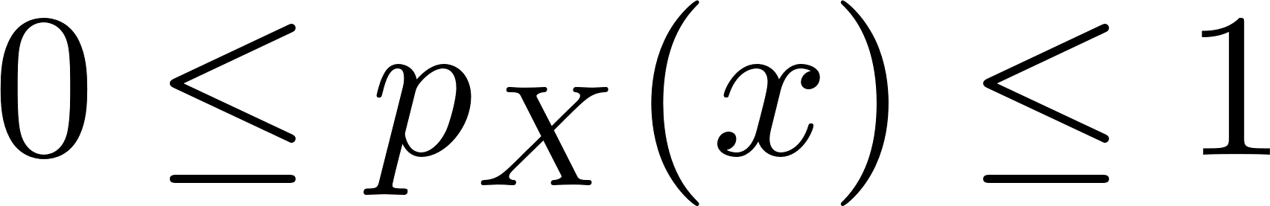
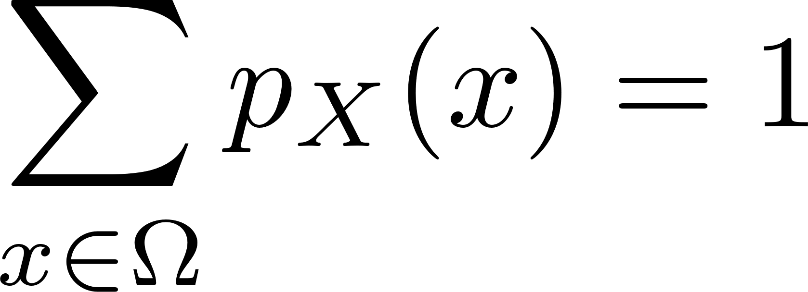
Probability Mass Function
A discrete Random Variable has a Probability Mass Function (PMF)
p_{X} (x) = P (X = x)
CS 355/555 Probability and Statistics for CS
13/36 10:18

Slide 20
Sum of two dice
x | #(x) |  | p_{X} (x)
2 | 1 | 1 36 | 1 36
3 | 2 | 2 36 | 1 18
4 | 3 | 3 36 | 1 12
5 | 4 | 4 36 | 1 9
6 | 5 |  | 5 36
7 | 6 | 6 36 | 1 6
8 | 5 |  | 5 36
9 | 4 | 4 36 | 1 9
10 | 3 | 3 36 | 1 12
11 | 2 | 2 36 | 1 18
12 | 1 |  | 1 36
CS 355/555 Probability and Statistics for CS

Slide 21
Number of heads out of 5 coins
x | #(x) | p_{X} (x)
0 | 1 | 1 32
1 | 5 | 5 32
2 | 10 | 10 32
3 | 10 | 10 32
4 | 5 | 5 32
5 | 1 | 1 32
CS 355/555 Probability and Statistics for CS

Slide 22
Functions of a Random Variable
Let X be a random variable, Y a random variable.
CS 355/555 Probability and Statistics for CS
17/36 10:18

Slide 23
Functions of a Random Variable
Let X be a random variable, Y a random variable.
X + 5 is a real valued function, so Z = X + 5 is a random variable.
CS 355/555 Probability and Statistics for CS
17/36 10:18

Slide 24
Functions of a Random Variable
Let X be a random variable, Y a random variable.
X + 5 is a real valued function, so Z = X + 5 is a random variable.
X + Y is a real valued function, so Z = X + Y is a random variable.
CS 355/555 Probability and Statistics for CS
17/36 10:18

Slide 25
Function of a Random Variable has a Probability Mass Function
Let Z = X + Y
p_{Z} (n) = P (Z = n) = P ((X + Y ) = n) = p_{X+Y} (n)
CS 355/555 Probability and Statistics for CS

Slide 26
Function of a Random Variable has a Probability Mass Function
Look at the difference of a throw:
Z = X − Y
z | #(z) | p_{Z} (z)
5 | 1 | 1 36
4 | 2 | 2 ₌ 1 36 18
3 | 3 | 3 ₌ 1 36 12
2 | 4 | 4 ₌ 1 36 9
1 | 5 | 5 36
0 | 6 | 6 ₌ 1 36 6
-1 | 5 | 5 36
-2 | 4 | 4 ₌ 1 36 9
-3 | 3 | 3 ₌ 1 36 12
-4 | 2 | 2 ₌ 1 36 18
-5 | 1 | 1 36
CS 355/555 Probability and Statistics for CS

Slide 27
Function of a Random Variable has a Probability Mass Function
Look at the absolute difference of a throw:
W = |X − Y |
w | #(w) | p_{W} (w)
5 | 2 | 2 ₌ 1 36 18
4 | 4 | 4 ₌ 1 36 9
3 | 6 | 6 ₌ 1 36 6
2 | 8 | 8 ₌ 2 36 9
1 | 10 | 10 ₌ 5 36 18
0 | 6 | 6 ₌ 1 36 6
CS 355/555 Probability and Statistics for CS

Slide 28
Function of a Random Variable
Let C be a random variable, a Celsius temperature reading.
Let F = ⁹ C + 32. Then F is a random variable representing
5
Fahrenheit temperature readings.
CS 355/555 Probability and Statistics for CS

Slide 29
Different types of Random Variables
There are different types of Random Variables.
CS 355/555 Probability and Statistics for CS

Slide 30
Discrete Uniform Random Variable
Discrete Uniform Random Variable
For finite range, P (X = a) = P (X = b) for all a, b
CS 355/555 Probability and Statistics for CS
23/36 10:18

Slide 31
Discrete Uniform Random Variable
Discrete Uniform Random Variable
For finite range, P (X = a) = P (X = b) for all a, b
Outcomes of throwing dice are uniform.
CS 355/555 Probability and Statistics for CS
23/36 10:18

Slide 32
Discrete Uniform Random Variable
Examples:
Flip a coin Throw one die Birthday
Etc.
CS 355/555 Probability and Statistics for CS

Slide 33

Bernoulli Random Variable
Bernoulli Random Variable
Each outcome = 1 with probability ρ, 0 with probability 1 − ρ
Toss a die, X=1 if <5, or X=2 if $≥5$
CS 355/555 Probability and Statistics for CS
25/36 10:18

Slide 34
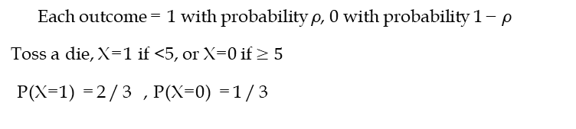
Bernoulli Random Variable
Bernoulli Random Variable
Each outcome = 1 with probability ρ, 0 with probability 1 − ρ
Toss a die, X=1 if <5, or X=0 if $≥5$
P(X=1) =2/3 , P(X=0) =1/3
CS 355/555 Probability and Statistics for CS
25/36 10:18

Slide 35
Binomial Random Variable pg 77
Binomial Random Variable
Random Variable = k = number of 1’s from n Bernoulli trials
Important note: different trials are independent.
CS 355/555 Probability and Statistics for CS
26/36 10:18

Slide 36
Binomial Random Variable pg 77
Binomial Random Variable
Random Variable = k = number of 1’s from n Bernoulli trials
CS 355/555 Probability and Statistics for CS
26/36 10:18

Slide 37
Number of heads out of 5 coins
x | #(x) | p_{X} (x)
0 | 1 | 1 32
1 | 5 | 5 32
2 | 10 | 5 16
3 | 10 | 5 16
4 | 5 | 5 32
5 | 1 | 1 32
CS 355/555 Probability and Statistics for CS
27/36 10:18

Slide 38
Number of heads out of 5 coins
x | #(x) | p_{X} (x)
0 | 1 | 1 32
1 | 5 | 5 32
2 | 10 | 5 16
3 | 10 | 5 16
4 | 5 | 5 32
5 | 1 | 1 32
( )
5 1 1 5 × 4 × 3 × 2 × 1 1 5 × 4 5
p (2) = P (X = 2) =
₂2 ₂3
=
=
₂6
=
X
2 (3 × 2 × 1)(2 × 1) 2⁵
16
CS 355/555 Probability and Statistics for CS
27/36 10:18

Slide 39
Binomial Random Variable pg 77
Binomial Random Variable
Random Variable = k = number of 1’s from n Bernoulli trials
1
If ρ = 1 − ρ = then
2
and the graph is symmetrical.
If ρ is small or large, the graph is skewed.
CS 355/555 Probability and Statistics for CS
28/36 10:18

Slide 40
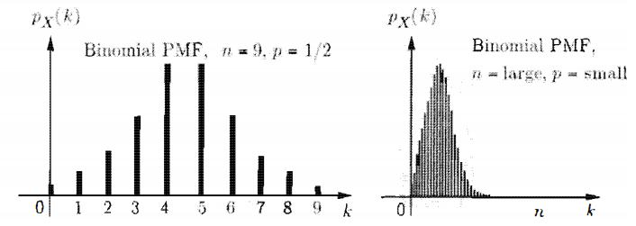
Binomial Random Variable pg 77
Binomial Random Variable
Random Variable = k = number of 1’s from n Bernoulli trials
If ρ is small or large, the graph is skewed.
CS 355/555 Probability and Statistics for CS
28/36 10:18

Slide 41
Geometric Random Variable pg 77
Geometric Random Variable
Geometric variable = # of trials to get a success
T
O
H

Slide 42
Geometric Random Variable pg 77
Geometric Random Variable
Geometric variable = # of trials to get a success
TT
T
O
TH
H

Slide 43
Geometric Random Variable pg 77
Geometric Random Variable
Geometric variable = # of trials to get a success
TTT
TT
T
TTH
O
TH
H
CS 355/555 Probability and Statistics for CS

Slide 44
Geometric Random Variable pg 77
Geometric Random Variable
Geometric variable = # of trials to get a success
p_{X} (k) = (1 − ρ)^{k−1}ρ
CS 355/555 Probability and Statistics for CS
30/36 10:18

Slide 45
Geometric Random Variable pg 77
Geometric Random Variable
Geometric variable = # of trials to get a success
p_{X} (k) = (1 − ρ)^{k−1}ρ
CS 355/555 Probability and Statistics for CS
30/36 10:18

Slide 46
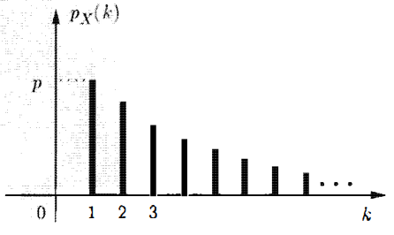
Geometric Random Variable pg 77
Geometric variable = # of trials to get a success
p_{X} (k) = (1 − ρ)^{k−1}ρ
Geometric Random Variable
CS 355/555 Probability and Statistics for CS
30/36 10:18

Slide 47
Poisson Random Variable
Poisson Random Variable
p (k) = e^{−λ λk}
X
k!
New letter:
λ
CS 355/555 Probability and Statistics for CS

Slide 48
Poisson Random Variable
Poisson Random Variable with parameter λ
p (k) = e^{−λ λk}
X
k!
Basically Binomial with small ρ and large n
−λ ^{λk}
n!
e
k
n−k
k! ≈ k!(n − k)! ^{ρ (1 − ρ)}
CS 355/555 Probability and Statistics for CS

Slide 49
Poisson Random Variable
Poisson Random Variable with parameter λ
p (k) = e^{−λ λk}
X
k!
Let X be the number of typographical errors in a book of n words.
CS 355/555 Probability and Statistics for CS
33/36 10:18

Slide 50
Poisson Random Variable
Poisson Random Variable with parameter λ
p (k) = e^{−λ λk}
X
k!
Let X be the number of typographical errors in a book of n words.
Let X_{i} be a random variable, 1 if the i^{th} word is misspelled.
CS 355/555 Probability and Statistics for CS
33/36 10:18

Slide 51
Poisson Random Variable
Poisson Random Variable with parameter λ
p (k) = e^{−λ λk}
X
k!
Let X be the number of typographical errors in a book of n words.
Let X_{i} be a random variable, 1 if the i^{th} word is misspelled.
p_{X} (1) pretty good.
p_{X} (1000) pretty low.
CS 355/555 Probability and Statistics for CS
33/36 10:18

Slide 52
Functions of a Random Variable
Let f be a function R → R, if X is a random variable, then f (X) is a random variable.
CS 355/555 Probability and Statistics for CS
34/36 10:18

Slide 53
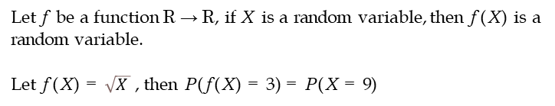
Functions of a Random Variable
Let f be a function R → R, if X is a random variable, then f (X) is a random variable.
Let f (X) = $\sqrt{X}$, then P (f (X) = 3) = P (X = 9)
CS 355/555 Probability and Statistics for CS
34/36 10:18

Slide 54
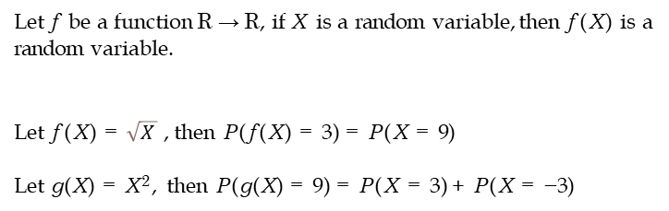
Functions of a Random Variable
Let f be a function R → R, if X is a random variable, then f (X) is a random variable.
Let f (X) = $\sqrt{X}$, then P (f (X) = 3) = P (X = 9)
Let g(X) = X², then P (g(X) = 9) = P (X = 3) + P (X = −3)
CS 355/555 Probability and Statistics for CS
34/36 10:18

Slide 55
Functions of a Random Variable
Example 2.1 pg 80
Let X be a random variable, an integer in [−4, 4]
1
if −4 ≤ x ≤ 4
p_{X} (x) =
9
0 otherwise
CS 355/555 Probability and Statistics for CS
35/36 10:18

